Slide 1
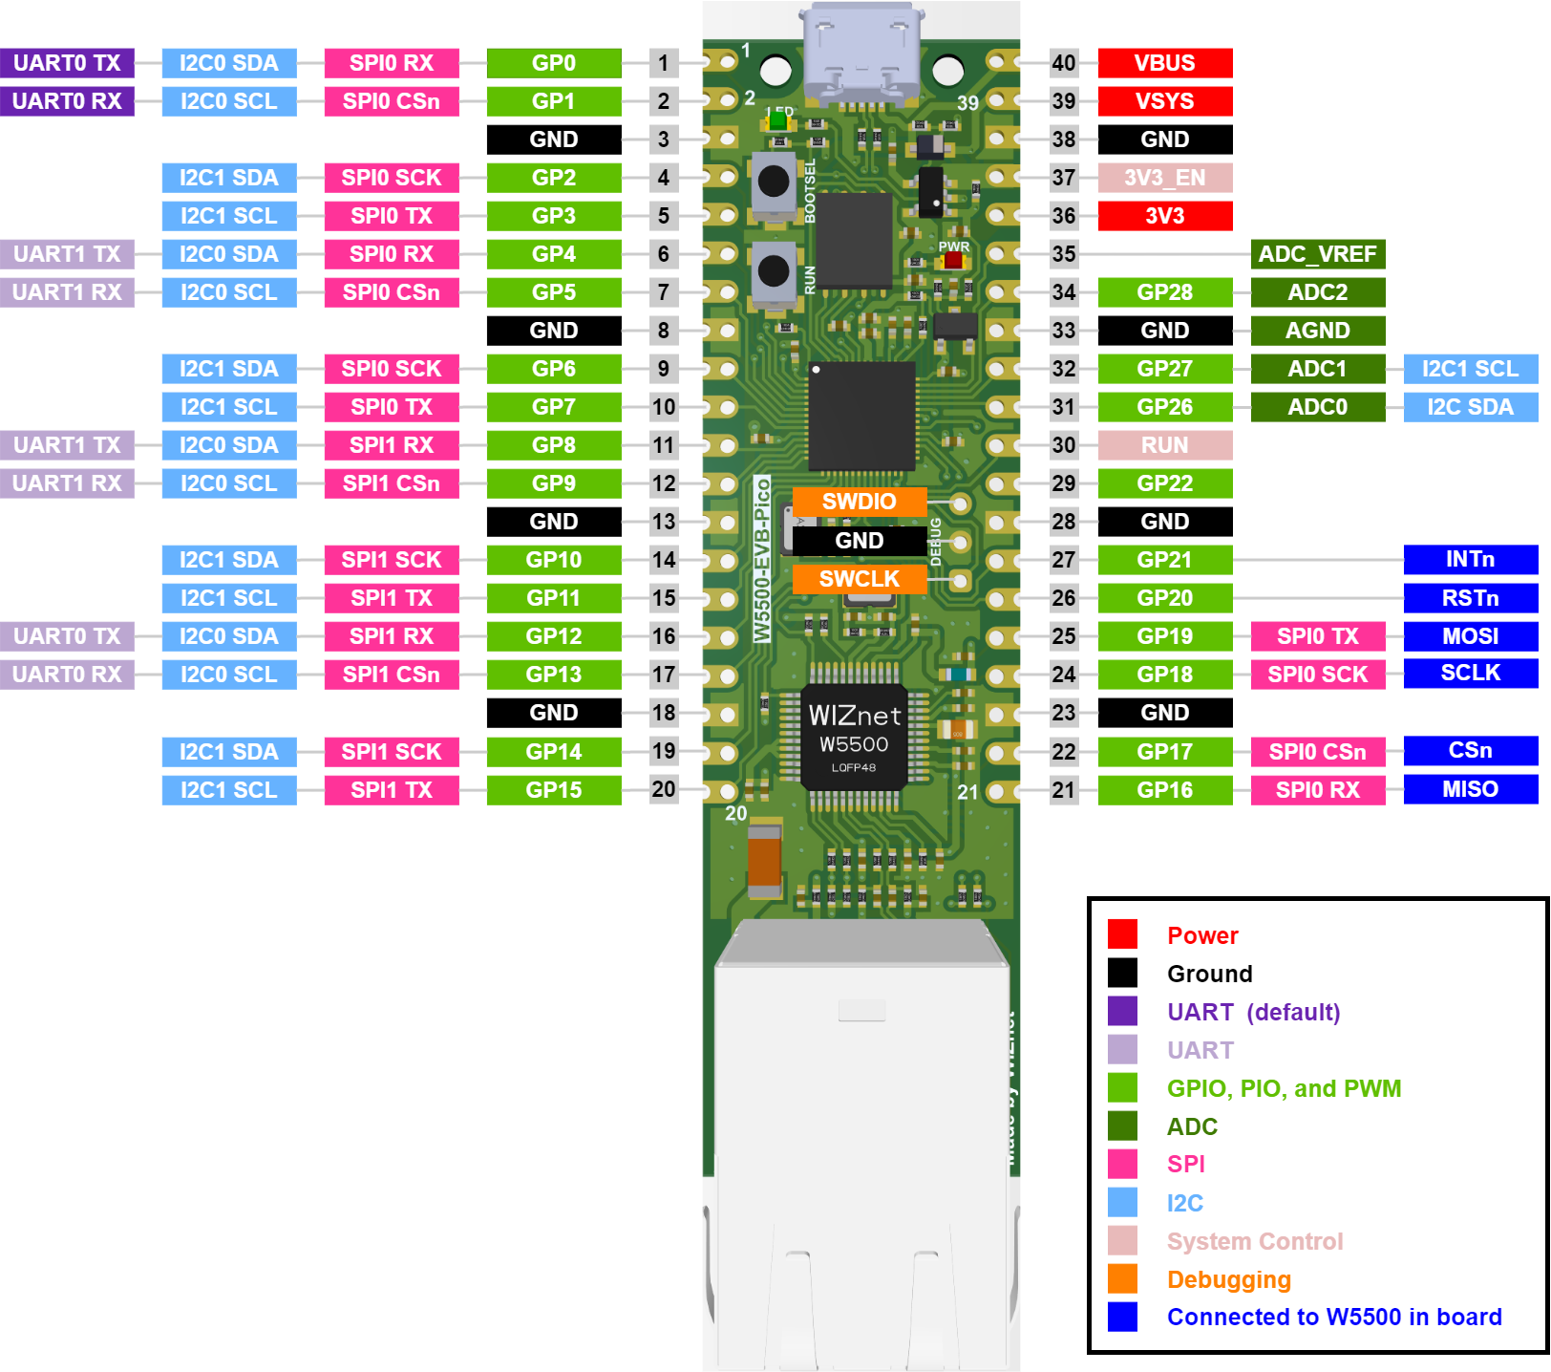

SWCLK
SWDIO
GND

